Slide 1
Breaking the barriers in payments
Artificial Intelligence
Machine Learning

Slide 2
Artificial Intelligence
ARTIFICIAL - MADE OR PRODUCED BY HUMAN
INTELLIGENCE - CAPACITY TO LEARN AND SOLVE
PROBLEMS
Confidential (Internal Use Only)

Slide 3
Artificial Intelligence - Definition
Artificial intelligence (AI) is an area of computer science that emphasizes the creation of intelligent machines that work and react like humans.
Confidential (Internal Use Only)

Slide 4




Artificial Intelligence
Some of the activities computers with AI are designed:
Speech Recognition
Facial Recognition
Temperature Recognition
Pattern Recognition
Confidential (Internal Use Only)

Slide 5
Artificial Intelligence
Adapt
Reason
Provide Solutions
Confidential (Internal Use Only)

Slide 6
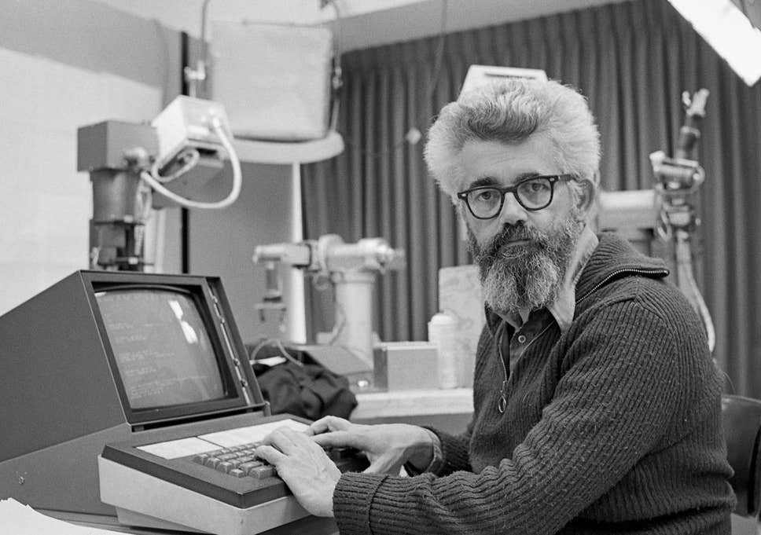

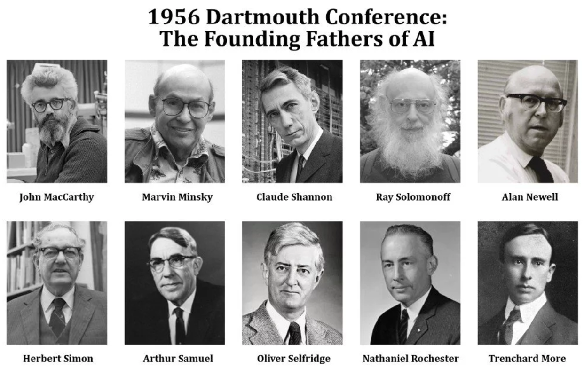
Artificial Intelligence – When is AI?
Confidential (Internal Use Only)

Slide 7


Artificial Intelligence – AI Winter
Confidential (Internal Use Only)

Slide 8



Artificial Intelligence – Breakthrough
Key Breakthrough
ALGORITHMS
Confidential (Internal Use Only)

Slide 9

Artificial Intelligence – AI Subfields!
Neural Networks
Evolutionary Computation
Vision
Robotics
Expert Systems
Speech Processing
Natural Language Processing
Machine Learning
Confidential (Internal Use Only)

Slide 10

ICE BREAKER

Slide 11

Rebus Puzzle

Slide 12
What is Rebus Puzzle?
a representation of words or syllables by pictures of objects or by symbols whose names resemble the intended words
Ano ang Rebus Puzzle?
isang representasyon ng mga salita o pantig sa pamamagitan ng mga larawan ng mga bagay o sa pamamagitan ng mga simbolo na ang mga pangalan ay kahawig ng mga nilalayong salita

Slide 13
Artificial Intelligence – Machine Learning
Confidential (Internal Use Only)

Slide 14
References…
https://nmap.org
https://www.rapid7.com/products/metasploit/
https://www.cryptors.org/
https://www.sans.org
https://www.offensive-security.com/
Confidential (Internal Use Only)

Slide 15
THANK
YOU
Confidential (Internal Use Only)

Slide 16
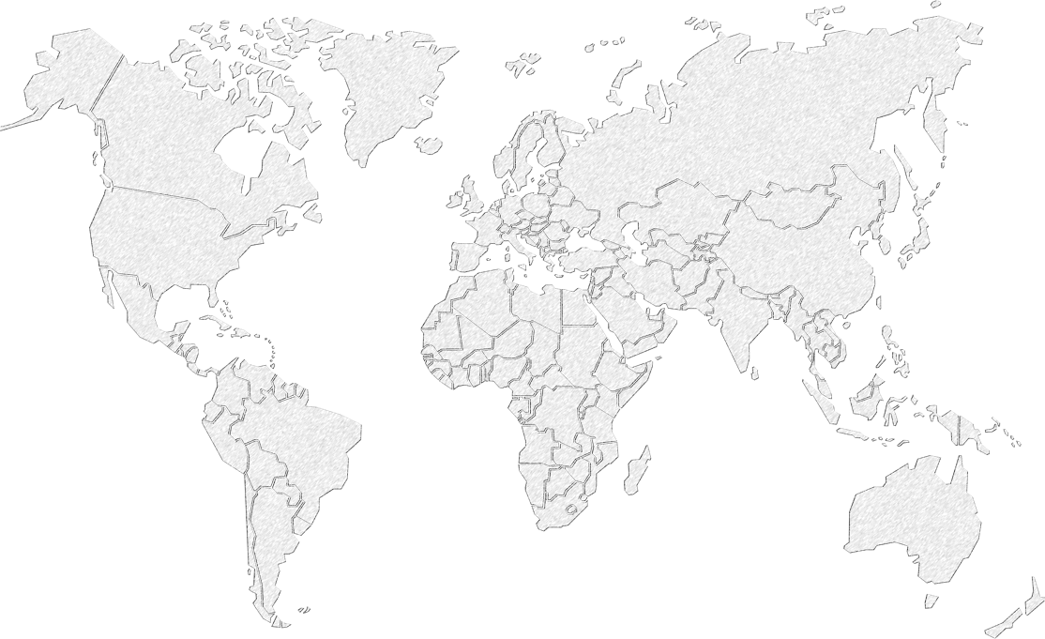
Any further questions?
US Office
HK Office
EU Office
PH Office
Contact:
Name
sherlyn.cruz@altpaynet.com
+639 15 009 4913
Skype: sherlyn.cruz
Confidential (Internal Use Only)

